Slide 1
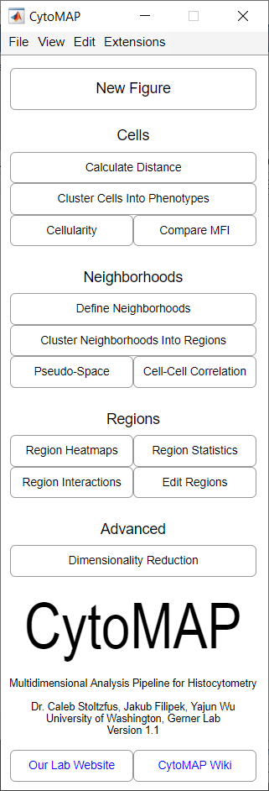
Main.png

Slide 2
File Dropdown:
load .csv or .mat
This either loads a previous workspace (.mat file) or loads data from .csv files where data should be formatted as Columns of parameters and rows of individual cells/objects. Individual .csv files are treated as separate phenotypes.
Import multiple samples
This loads multiple samples, assuming the data is saved as individual .csv files for each phenotype with each sample in a unique folder containing only that sample’s .csv files.
Import data from .wsp
This loads data from FlowJo’s .wsp files. It is still a bit limited and breaks if there are ellipse gates, logic gates, and probably a few other cases I haven’t encountered yet.
Save Workspace
This saves the current workspace as a .mat file.
Export Full data tables as .csv
This generates .csv files for the different cell types or neighborhoods. These can then be loaded into FlowJo.
Export data for prism
This also exports .csv files of the cell MFI or neighborhoods, but in a more convenient format for copying the data to prism for plotting.

Slide 3
View dropdown:
View data table
This brings up a table which displays the number of cells in each phenotype and the sample names. In this table you can merge samples, delete phenotypes/samples, etc.
Customize Interface
This brings up a menu where you can edit the font size, background window color etc.. (It currently doesn’t change the main windows color/font etc.)
Edit dropdown:
Edit Region Colors
This brings up an interface where you can edit the colors assigned to each region, change the region order, and/or combine regions.
Edit Channels
This brings up an interface where you can edit the channels: e.g. you can use channel arithmetic to shift the position channel, or combine two MFI channels.
Edit Neighborhoods
This brings up an interface where you can edit the neighborhoods: e.g. you can use neighborhood arithmetic to combine the number of cells per neighborhood of two cell types.

Slide 4
Extensions dropdown:
Bar_Graph_Function (violin plots don’t export correctly) [Bar/Violin Plots]
This makes bar graphs or violin plots of the MFI per cell, which can then be exported and plotted in Prism etc.
Edit_Figures_Template
This is meant as a template for a user defined extension to set figure preferences (e.g. axes, colorbar, n’ stuff) that can then be easily applied to any figure.
Edit_All_Figures_Template
This is similar to Edit Figures Template, except it applies the figure settings to all open figures.
Nearest_Neighbor_Analysis
This calculates the percentage of each cell type within K nearest neighbors for user defined cell types, then makes heatmaps of how much these neighbors differ from the expected neighbors based on the total number of each cell type.
Compare_Cells_With_Tandom_Tree
This uses a Random Tree to classify multiple user selected cell types. It then outputs the primary channels which were used to classify cells into these cellular groups. This is a quick way to see what are the most important channels capable of distinguishing between cell types: e.g. this will show you what is different between clustered and non-clustered cells across all defined channels.
Ripleys_Distribution_Analysis
This uses the Ripley K function to explore the spatial distribution of cells. It can be used to compare to randomly distributed cells and describe weather cells are clustered or not, and on what length scale they are clustered or dispersive.
Overlay_Confocal_Images (work in progress)
This will load in an .ims and allow the user to overlay cells, neighborhoods, or regions on top of the loaded confocal image.
Calculate_Dispersion (work in progress)
This will calculate the dispersion coefficient

Slide 5
General Function:
New Figure
Opens a new figure to plot cells/neighborhoods/color-coded overlays etc.

Slide 6
Functions geared towards cellular analysis:
Calculate Distance
Calculates the distance between cells, polygons, points, surfaces, or nearest regions
Cluster Cells (or Neighborhoods)
Allows the user to cluster either cells or neighborhoods into either cellular phenotypes or regions, respectively.
Plot Cellularity
This generates heatmaps of the number of cells per sample. The use can compare groups of samples and, using the “volume” input column, make some cells/volume plots.
Compare MFI
This is meant to be a quick way to plot and compare the average MFI of different cell populations across samples.

Slide 7
Neighborhood Specific Functions:
Define Neighborhoods [Previously: Raster Scan Neighborhoods]
This generates a table of neighborhoods, either centered on a specified cell type, or even distributed across the sample space. The number of cells and total MFI of each channel are calculated for each neighborhood. (Need to combine cell-centered and raster scanned)
Cluster Neighborhoods (or Cells)
Allows the user to cluster either cells or neighborhoods into either cellular phenotypes or regions, respectively.
Pseudo-Space
This generates a line plot of the number of cells per neighborhood, for neighborhoods sorted in a user defined manner.
Cell-Cell Correlation
This calculates and plots the correlation (or other similar metrics) between the number of cells per neighborhood.

Slide 8
Region Specific Functions:
Region Heatmaps
This plots heatmaps of the MFI, or number of cells per neighborhood, sorted by region.
Region Statistics
This generates plots of multiple statistics like the numbers of cells/fold change etc. of the neighborhoods in the various regions.
Region Interactions
This calculates and plots the percentage of shared border between regions.
Edit Regions
This brings up an interface where you can edit the colors assigned to each region, change the region order, and/or combine regions.

Slide 9
Advanced Functions:
Dimensionality Reduction [Previously: Reduce Dimensions]
This calculates t-SNE/UMAP/PCA etc. for either individual cells using their MFI or neighborhoods using their cells per neighborhood etc.

Slide 10
Links:
Our Lab Website
Opens the Gerner Lab website
CytoMAP Wiki
Opens the Cytomap Wiki page on Gitlab

Slide 11
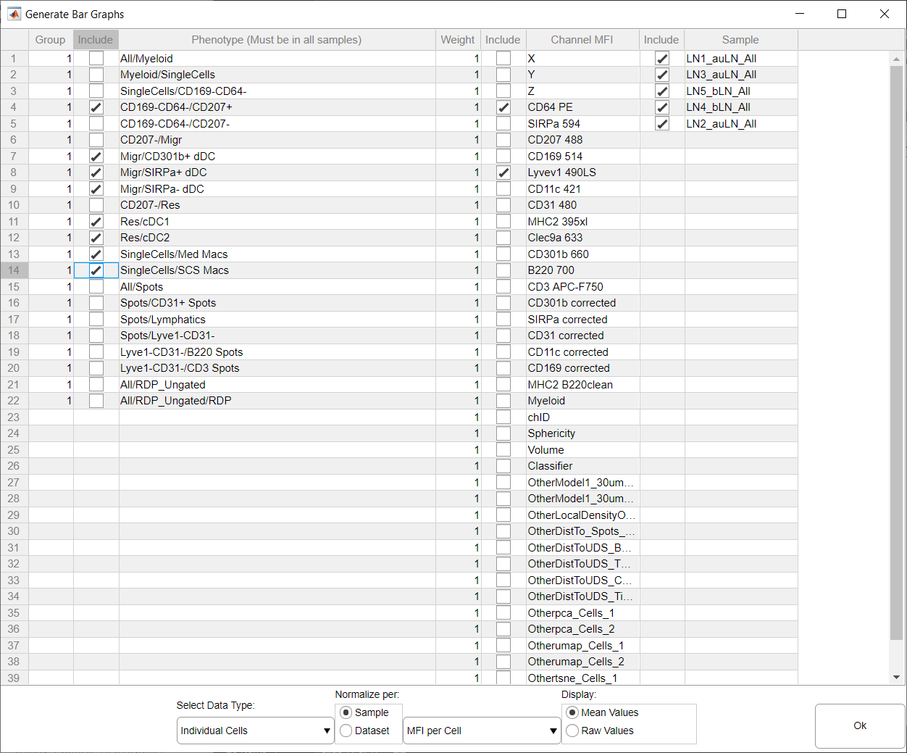
Select Cell Types
Select Channels
Plot Average or Violin plots
Generate the plots

Slide 12
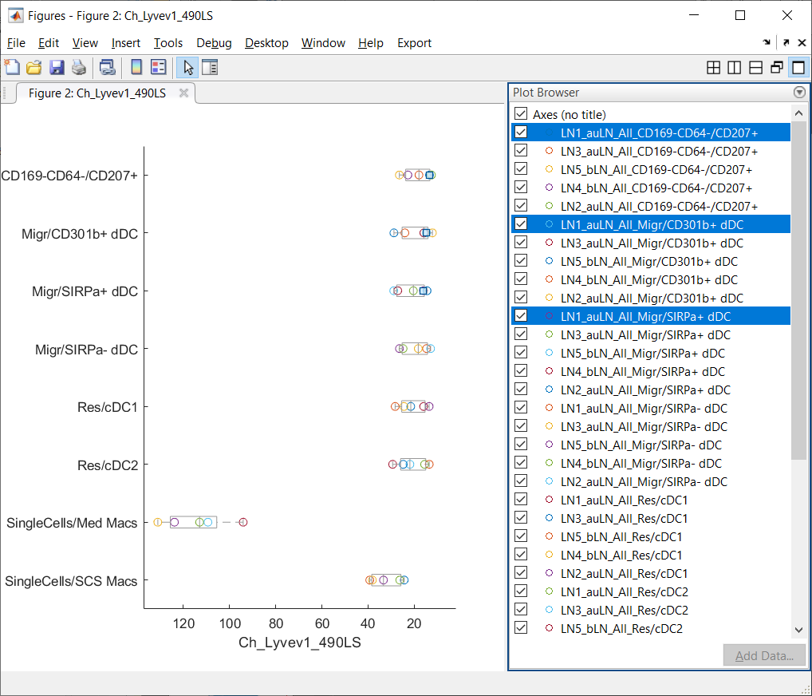
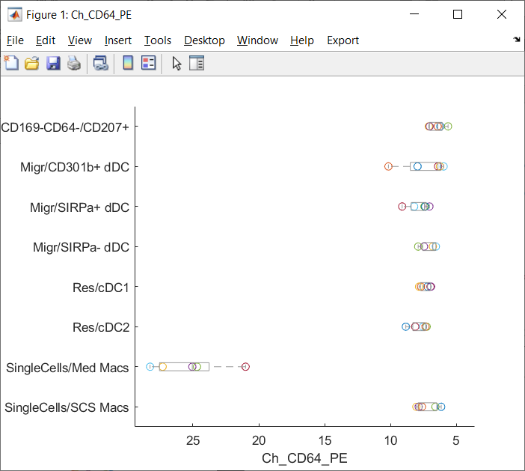
Plots:
Each channel selected will generate a plot
Select View > Plot Browser to see the legend

Slide 13
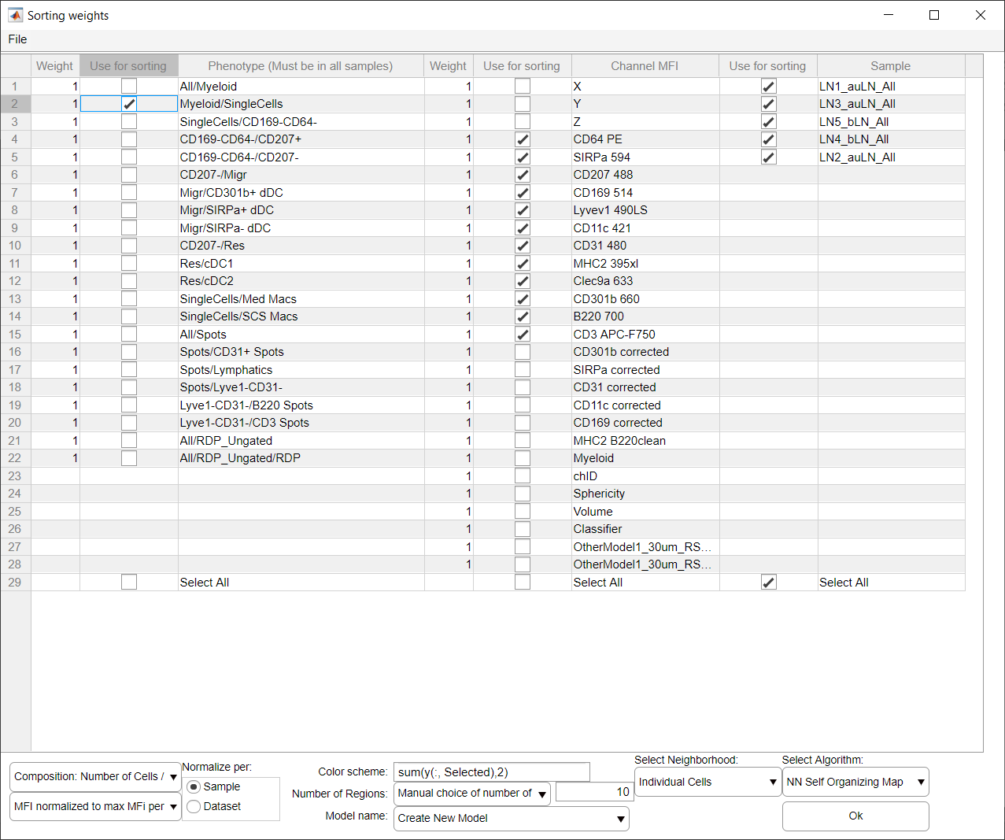
Select which Cells to cluster
Select which samples to include
Select which channels to use during clustering
Select Individual Cells
Click Ok to begin clustering

Slide 14
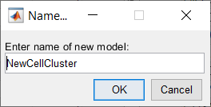
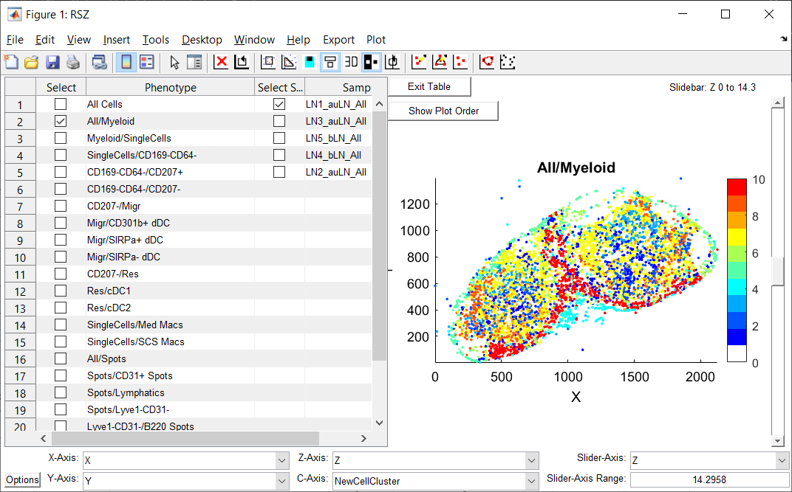
Once your model is trained it will show up as a new channel for plotting
Cells you did not select for clustering will be assigned to group 0, and will be color coded white on any plots
Use gating to name the new cell populations
Select your new model on the color axis
To use these cell definitions you will need to gate on the populations and give them names

Slide 15
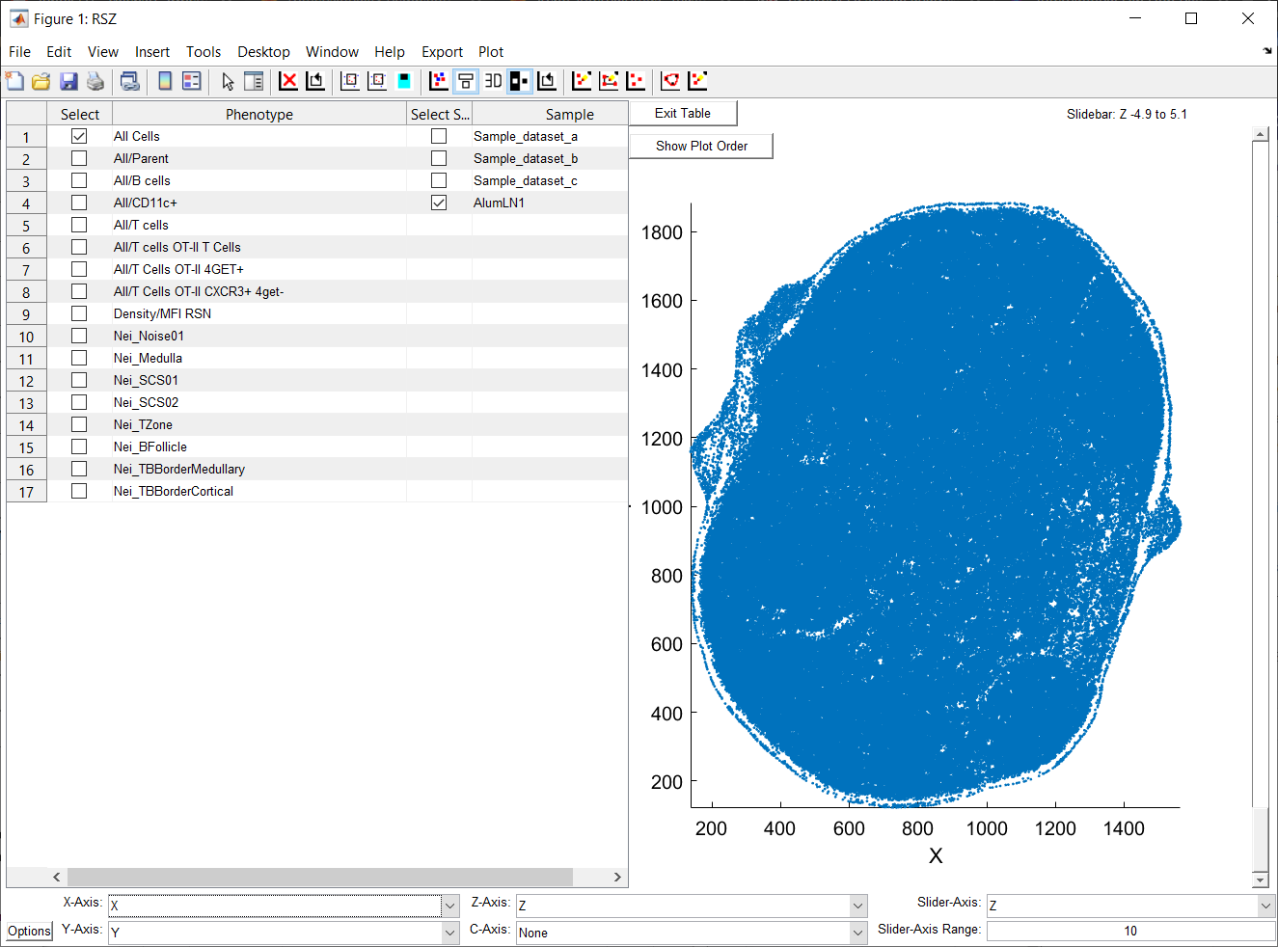

Slide 16
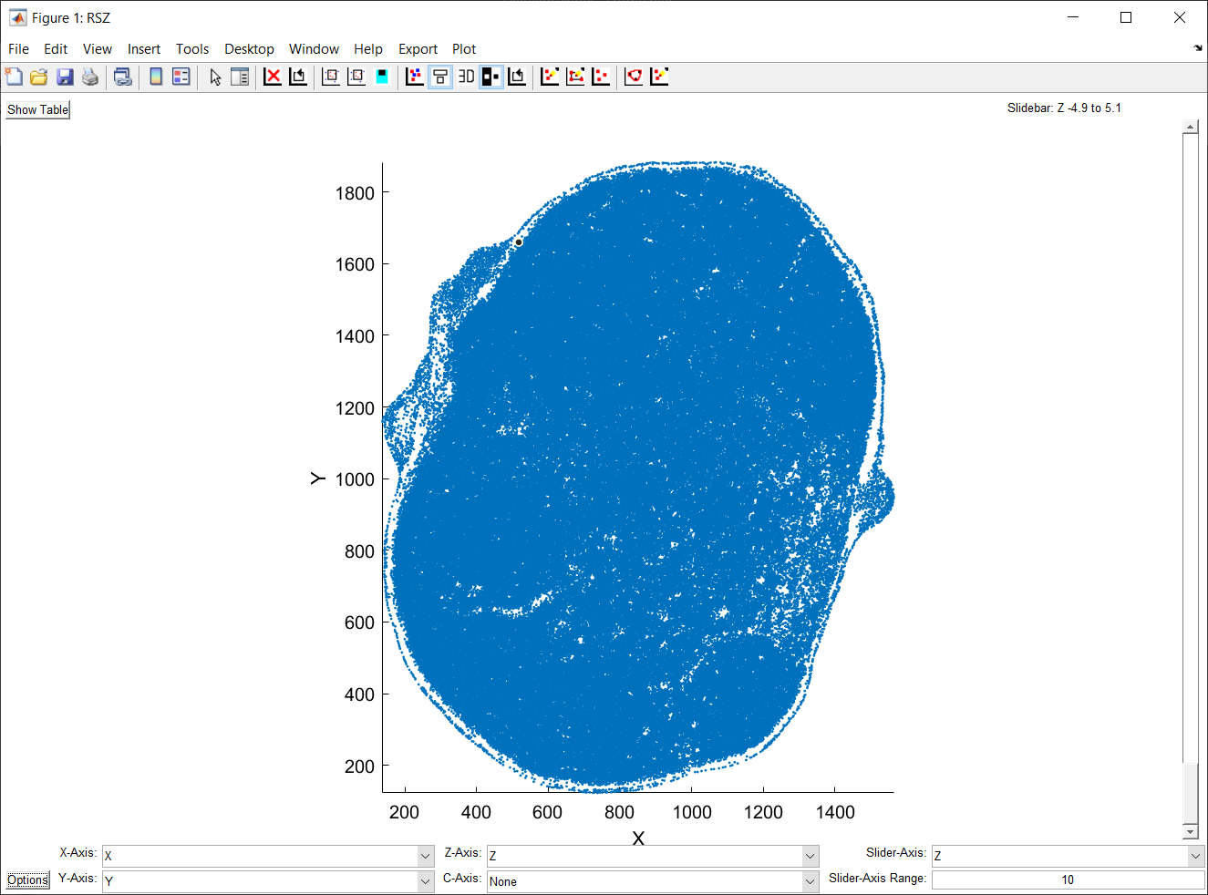
3
1
2
7
4
5
6

Slide 17
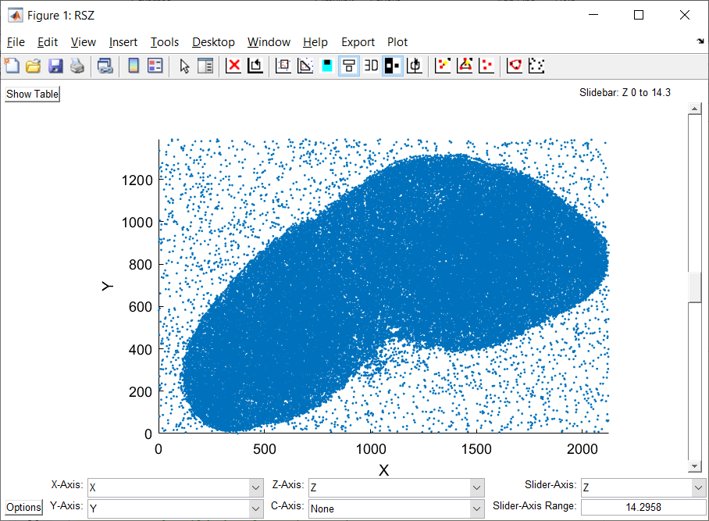

Slide 18
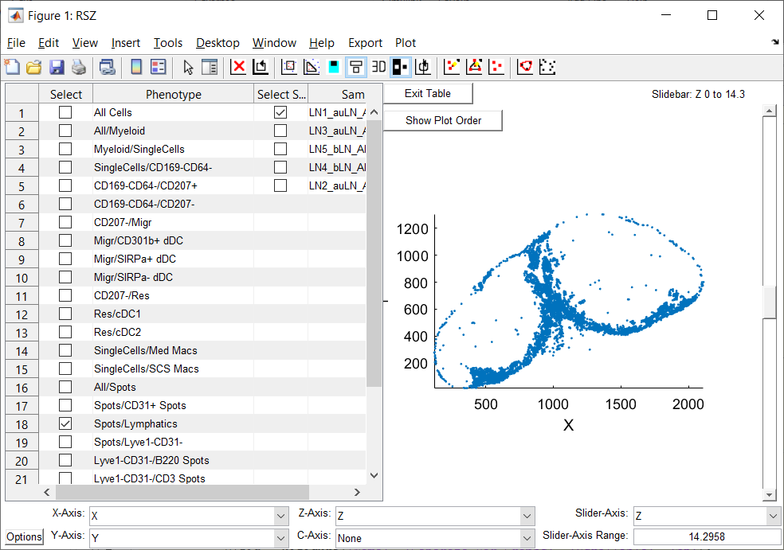

Slide 19
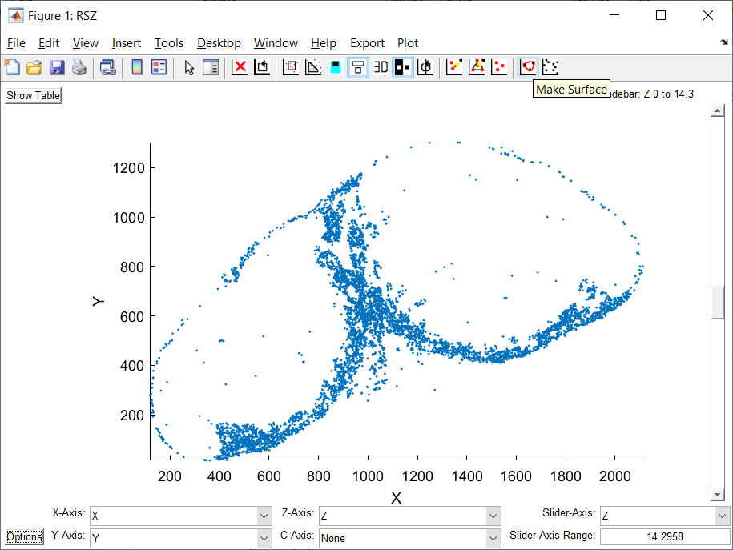
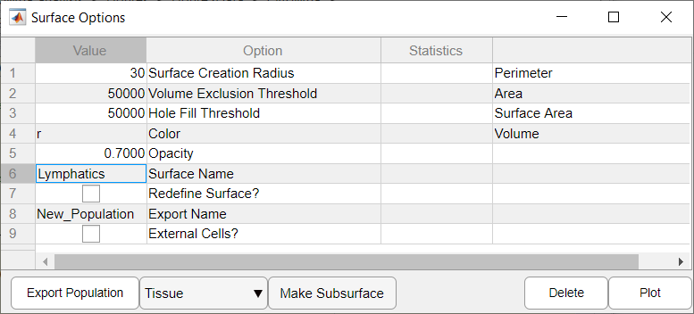
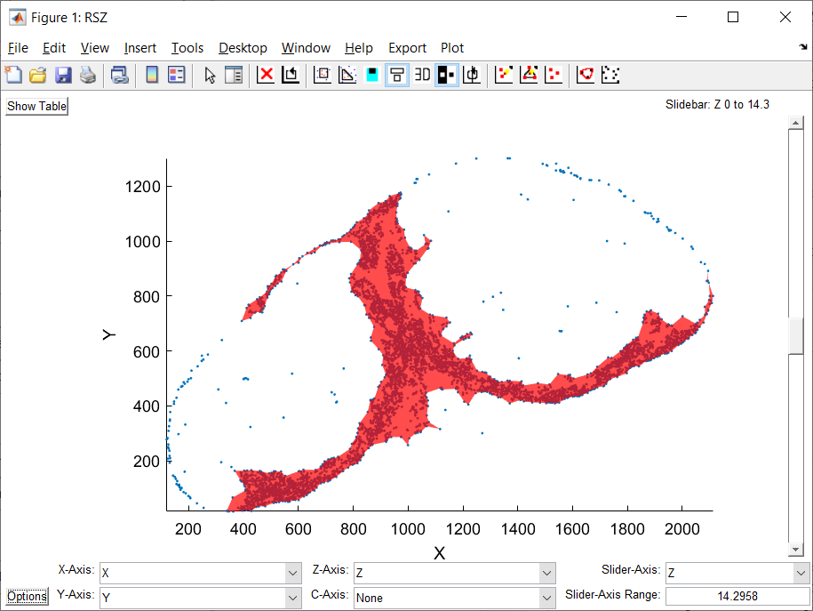

Slide 20
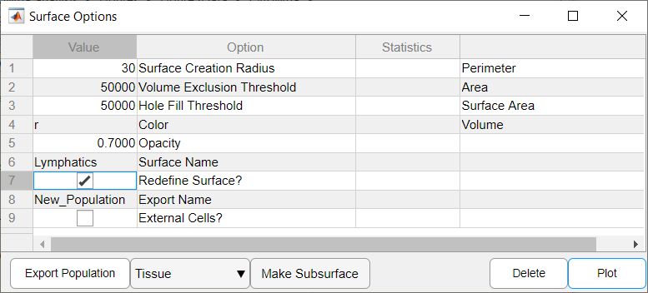
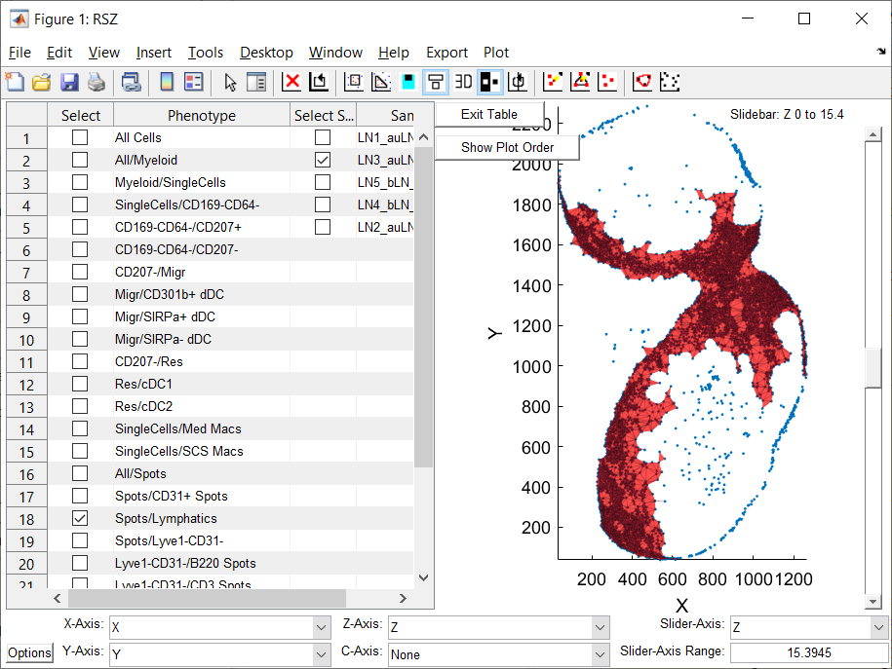

Slide 21
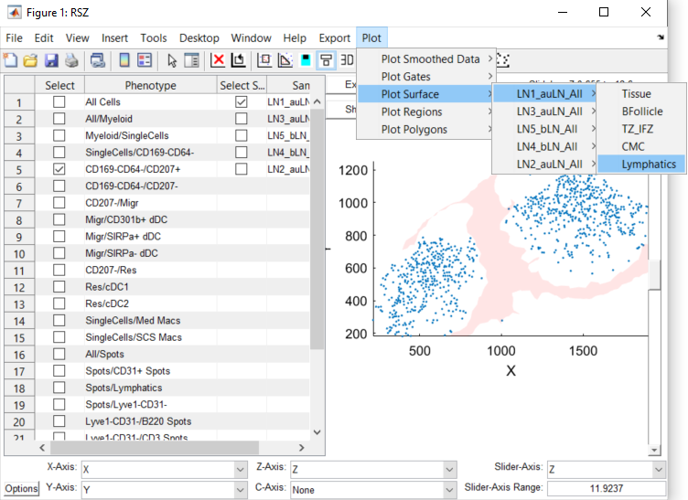
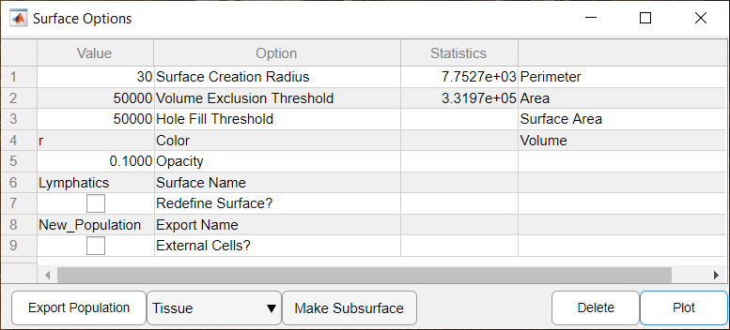

Slide 22
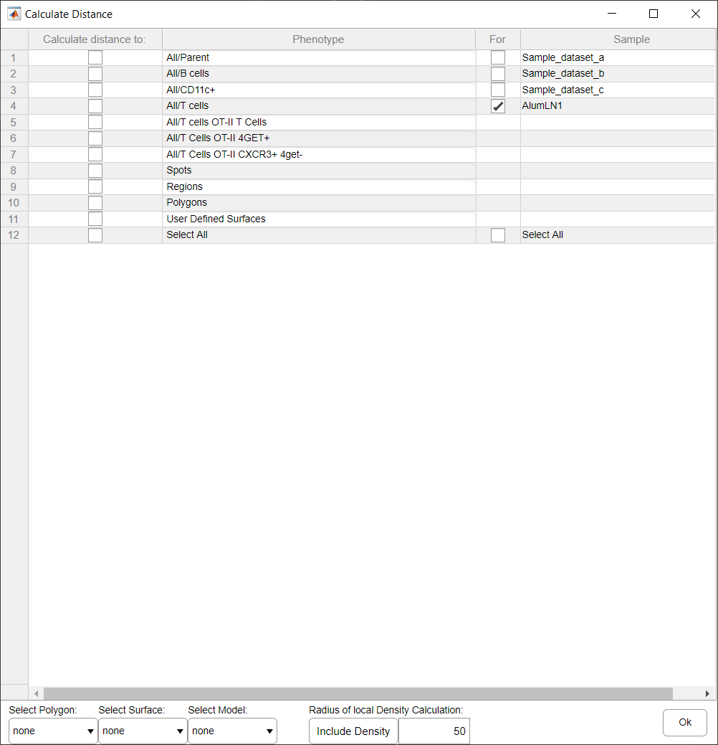
1
2
3
4
5
6
7

Slide 23
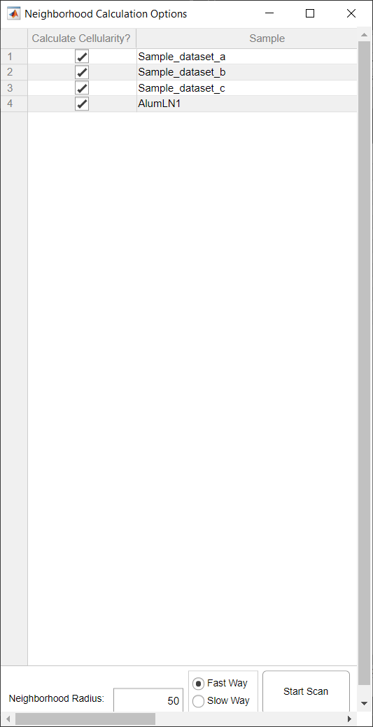
1
2
3
4

Slide 24
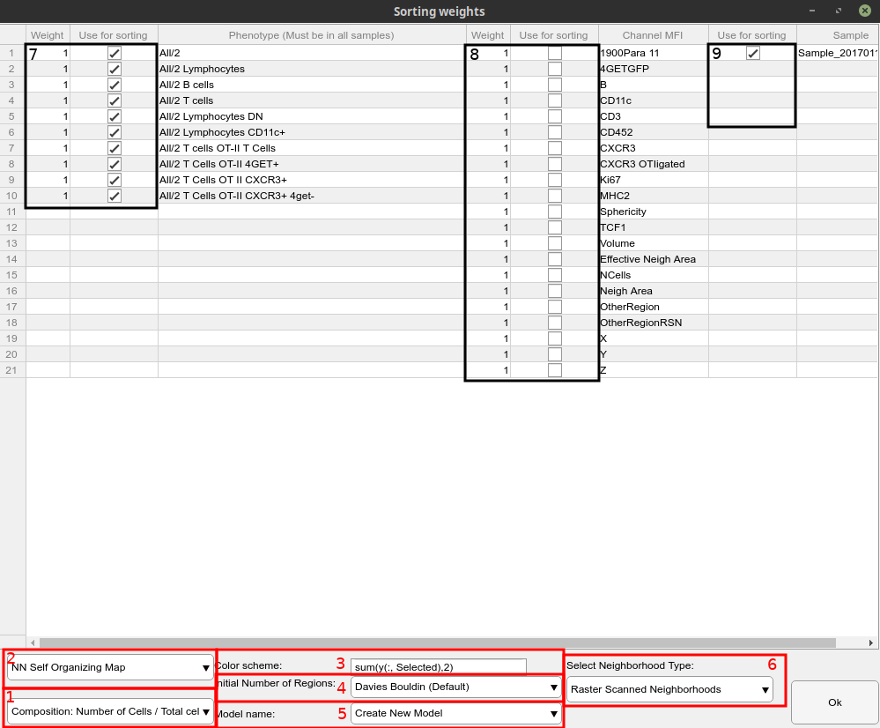

Slide 25
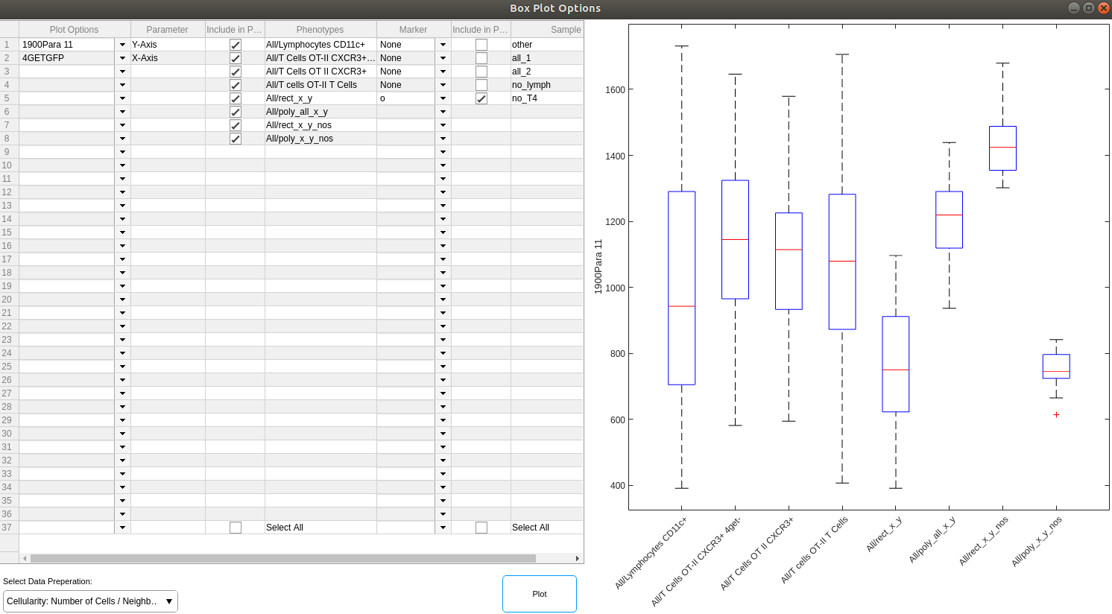

Slide 26
